Slide 1

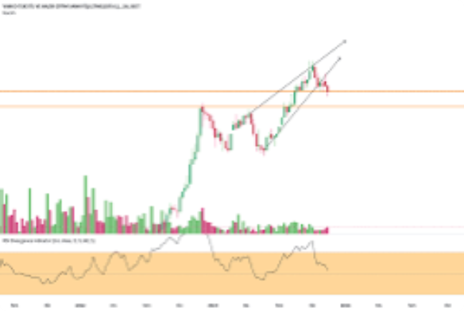
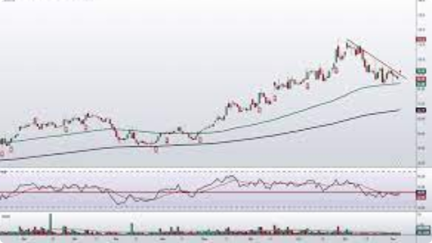
PRICE PREDICTION OF VAKKO SHARES TRADED ON THE STOCK EXCHANGE USING MACHINE LEARNING

Slide 2

IMPORTANCE AND PURPOSE OF OUR PROJECT
Predicting stock prices is an important source of information for investors. By predicting the future direction of stock prices, investors can make better investment decisions. However, predicting stock prices is a very difficult task. Stock prices are affected by a variety of factors, and it is difficult to predict the future values of these factors. With our project, we made it easier to predict the future direction of stock prices.

Slide 3
Share Price Prediction Methods
Stock analysis: fundamental and technical analysis
Predicting stock prices with Moving Average techniques
Introduction to LSTMs
Predicting stock prices with the LSTM model

Slide 4

CONTENTS:
dataset
moving averages
normalization
LSTM
Data train - Data test model training
Price prediction
LSTM AND DECISION TREE COMPARISON
Epoch production
MAE (Mean Absolute Error)

Slide 5
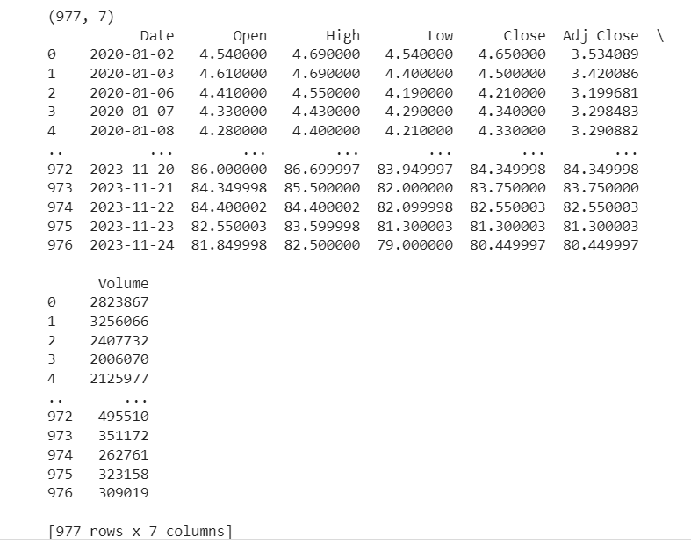
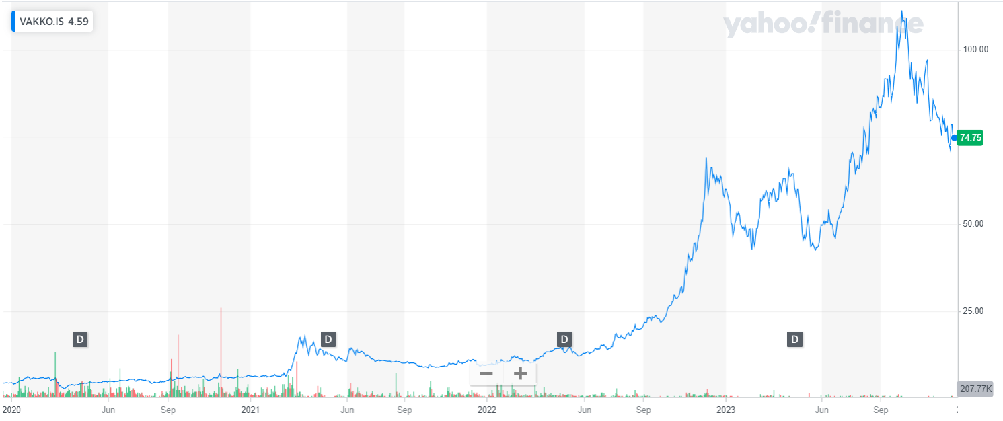
DATASET

Slide 6
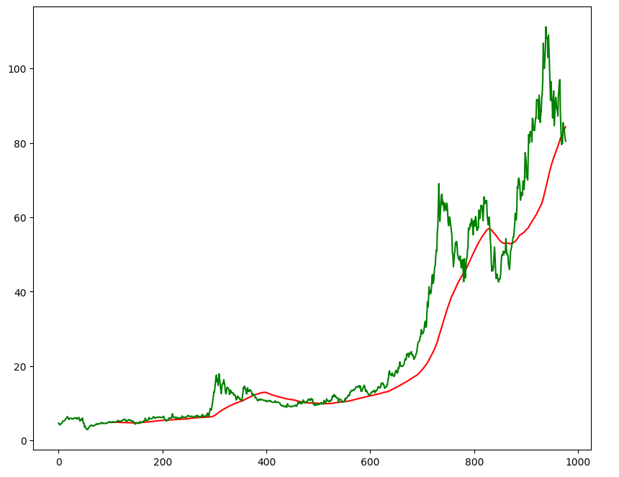
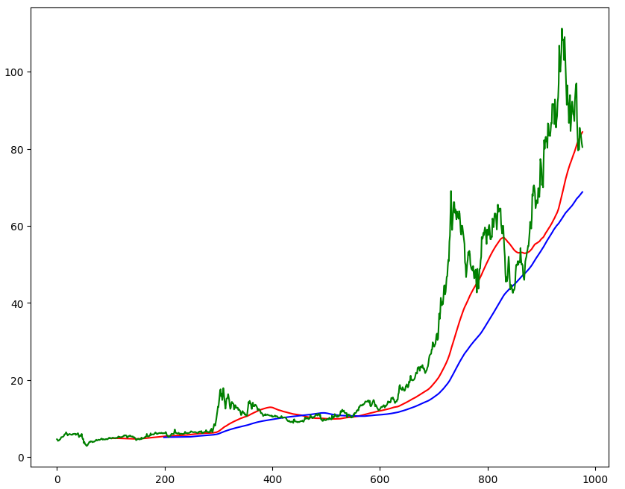
MOVING AVERAGE
100 DAYS
200 DAYS

Slide 7
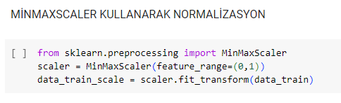
NORMALIZATION
N ormalization is the process of shrinking the values of a feature set to a specific range or scale. This is done to correct large value differences between features and help algorithms perform better.

Slide 8
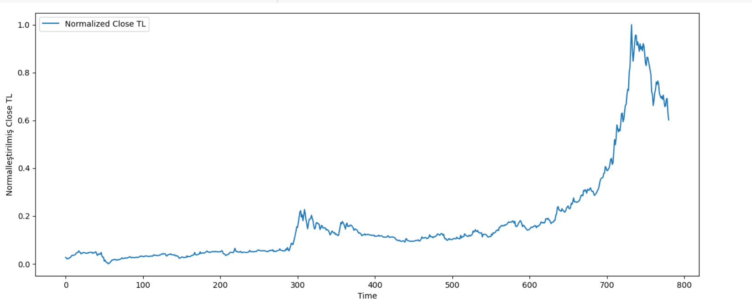
NORMALIZATION GRAPH

Slide 9
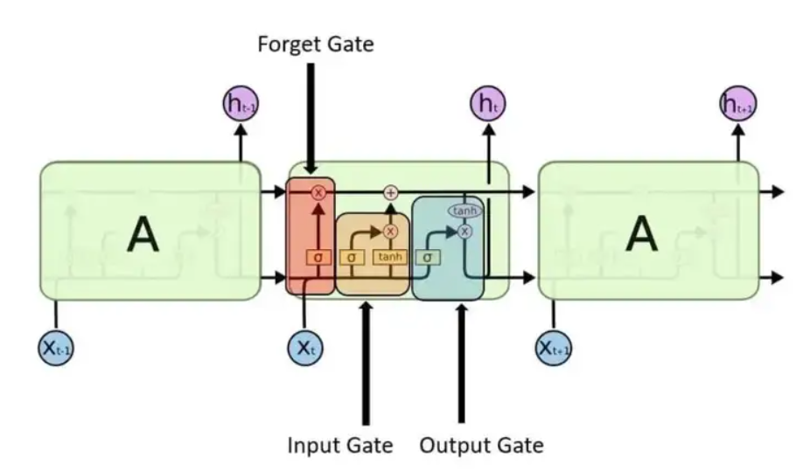
LSTM(LONG-SHORT TERM MEMORY)
LSTMs are an improved version of recurrent neural networks (RNNs). (RNN: used to recognize patterns when past results have an impact on the current result.)
LSTMs are a type of RNN that remembers information over long periods of time, making them more suitable for predicting stock prices.

Slide 10
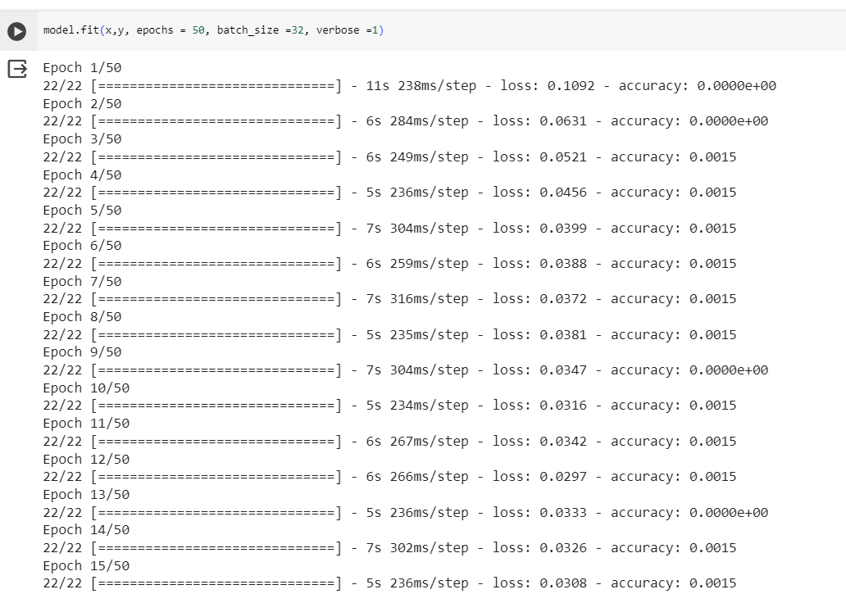
EPOCH PRODUCTION
a machine learning model spends its entire time on the training data. An epoch represents an iteration in which the model sees all the training data once and updates its weights. Often, multiple epochs are used to train a model. Each epoch can help the model learn and generalize better.

Slide 11
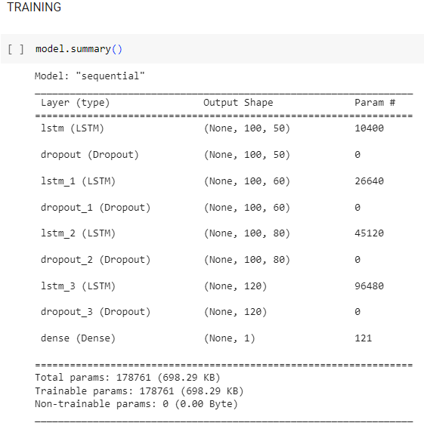
TRAINING
It refers to the process of a model learning a specific task . In this process, the model learns to perform a specific task, usually using a training data set.

Slide 12
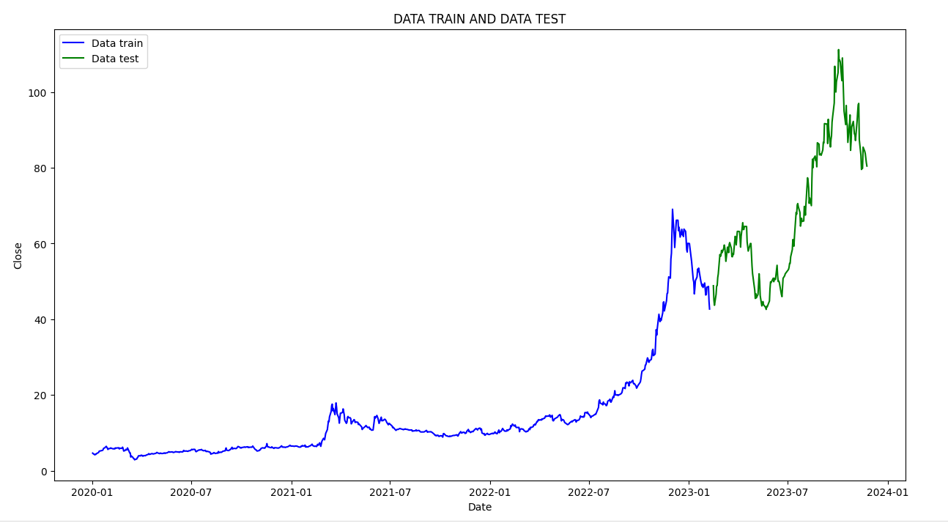
DATA TRAIN – DATA TEST (80% - 20%)

Slide 13
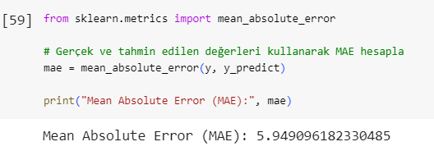
MEAN ABSOLUTE ERROR(MAE)

Slide 14
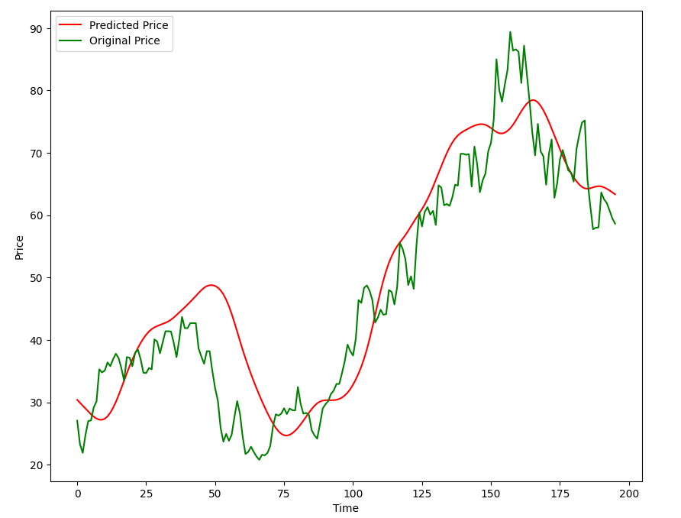
PRICE ESTIMATE

Slide 15
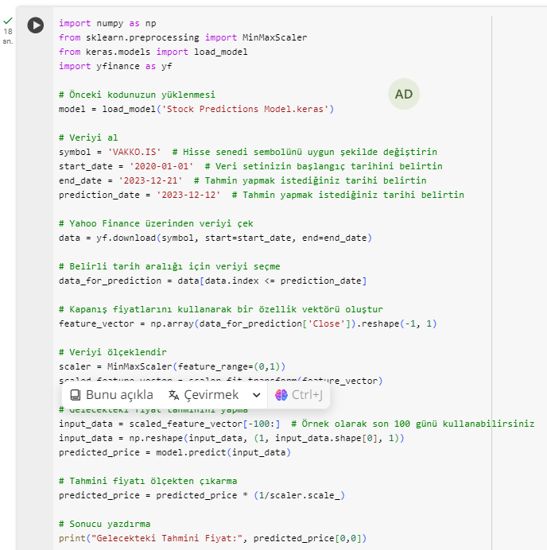
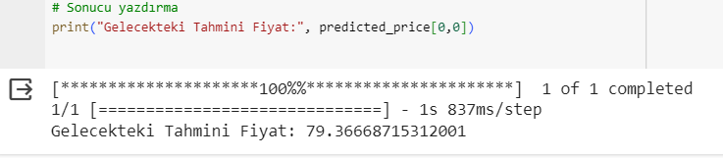
ESTIMATED FUTURE PRICE

Slide 16
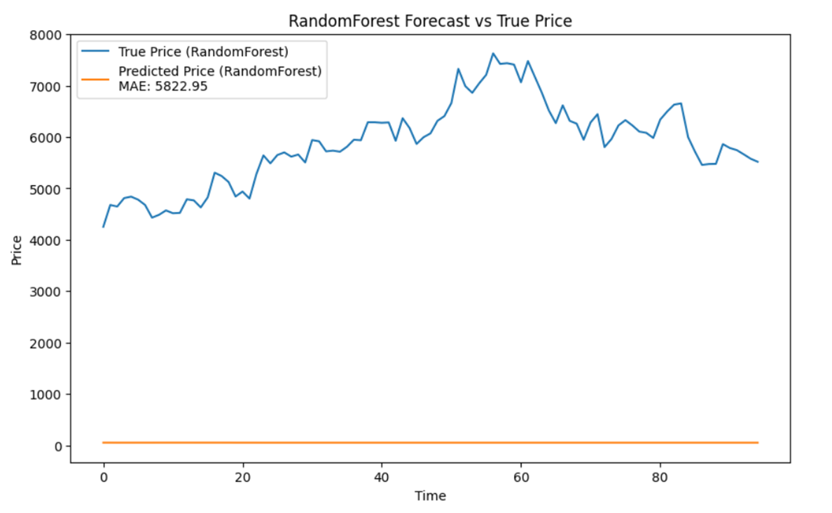
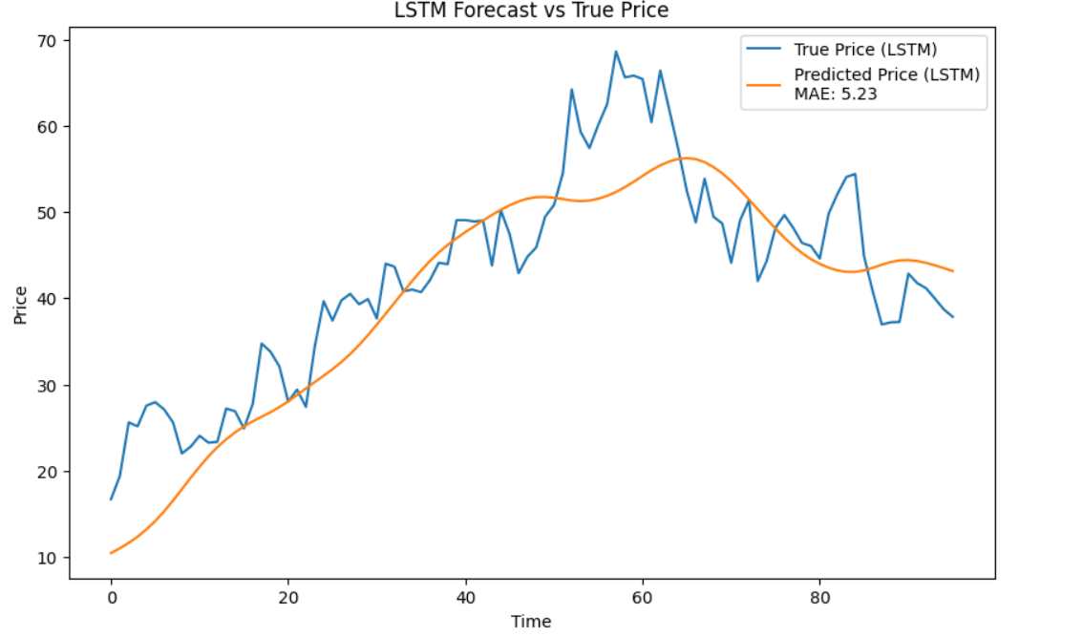
LSTM AND DECISION TREE COMPARISON

Slide 17
LSTM AND DECISION TREE COMPARISON
Data Type:
If you are working with time-dependent data such as time series, recurrent neural networks such as LSTM may be more appropriate.
If you are working with structured and tabular data, decision trees can be more effective.
Data Amount:
If you have a small data set, decision trees are generally faster and perform better.
If you have a large data set and especially want to learn complex relationships over time, deep learning models such as LSTM may be preferable.
Explainability:
If it is important for the model to be explainable, a decision tree may be preferred. Decision trees can explain each decision under a particular feature or condition.
If explainability is less important and more complex relationships need to be learned, deep learning models such as LSTM can be considered.
Computing Power and Time:
LSTM and other deep learning models generally require more computing power and training time.
Decision trees can be trained faster and make predictions faster.
Hyperparameter Setting:
Deep learning models such as LSTM generally include more hyperparameters, and tuning these parameters is more complex.
Decision trees generally have fewer hyperparameters and can be tuned more easily.

Slide 18
LSTM ADVANTAGES
LSTM is a deep learning model widely used in a variety of tasks such as natural language processing, machine translation, time series analysis, and voice recognition due to its ability to process data with long-term dependencies. The main advantages of LSTMs are:
- Ability to deal with long-term dependencies: LSTMs can store historical data in their long-term memory and use this information to improve their future predictions. This makes LSTMs ideal for tasks where historical data is important for predicting future behavior.
- Ability to capture complex structures of data: LSTMs are designed to capture complex structures of data. This makes LSTMs ideal for tasks such as natural language processing, since natural language often has complex structures.
- Generalizability : LSTMs can be generalized to new data. This makes LSTMs ideal when they need to be trained on new datasets.

Slide 19

SUMMARY
Stock price prediction is an important source of information for investors.
Predicting stock prices is a very difficult task.
LSTM networks are deep learning networks used to predict stock prices.
LSTM networks can store historical data in their long-term memory and use this information to improve their future predictions.
The project shows that LSTM networks can be effective for predicting stock prices.

Slide 20
SOURCE
https://towardsdatascience.com/predicting-stock-prices-using-a-keras-lstm-model-4225457f0233
https://www.ris-ai.com/stock-price-prediction-with-machine-learning
https://pythoninoffice.com/stock-price-prediction-with-lstm-in-python/
https://neptune.ai/blog/predicting-stock-prices-using-machine-learning
https://medium.com/neuronio/predicting-stock-prices-with-lstm-349f5a0974d4
https://thinkingneuron.com/predicting-stock-prices-using-deep-learning-lstm-model-in-python/
https://www.geeksforgeeks.org/stock-price-prediction-project-using-tensorflow/
https://www.kaggle.com/code/bryanb/stock-prices-forecasting-with-lstm
https://finance.yahoo.com/

Slide 21
ARTICLES
[1] ARSLANKAYA Seher & TOPRAK Şevval (2021), Using Machine Learning and Deep Learning Algorithms for Stock price Prediction
[2] TOKMAK Mahmut (2022), Stock Price Prediction Using Long-Short Term Memory Network
[3] Mehar Vijh & Deeksha Chandola & Vinay Anand Tikkiwal & Arun Kumar (2020), Stock closing price Prediction using Machine Learning Techniques
[4] Jaydip Sen (2018), Stock price Prediction Using Machine Learning and Deep Learning Frameworks
[5] Shunrong Shen & Haomiao Jiang & Tongda Zhang (2012), Stock Market Forecasting Using Machine Learning Algorithms

